Slide 1
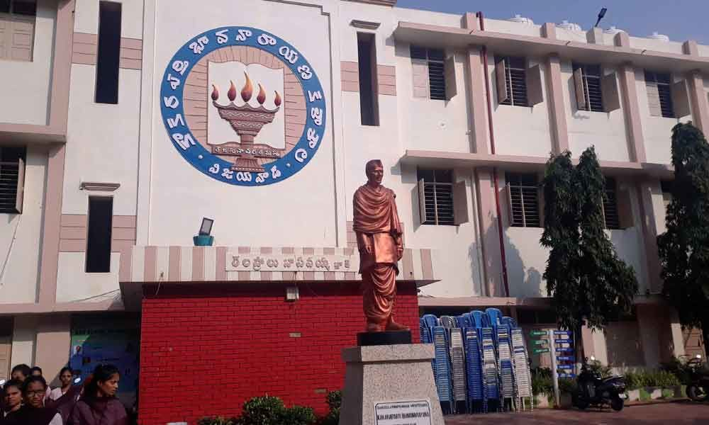

WELCOME TO NAAC PEER TEAM

Slide 2

Bonjour
Hola
THE
TRANSLATOR
Hello

Slide 3
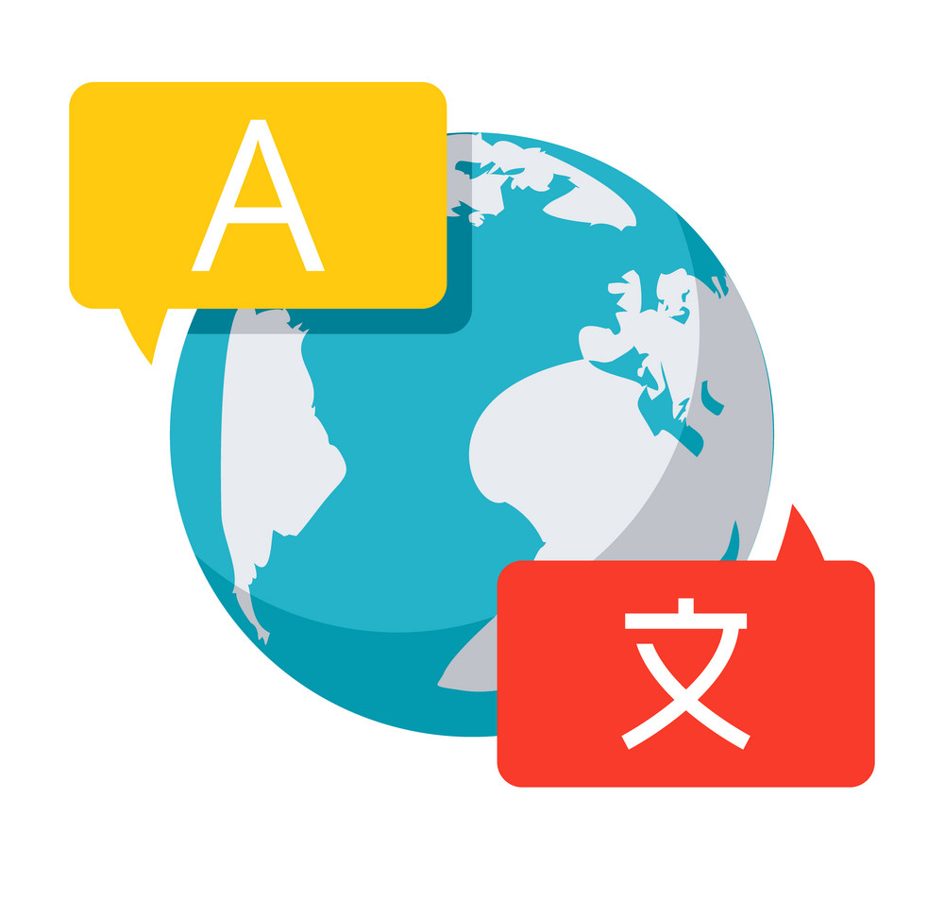
Introduction
A language translator is a tool or system that converts text or speech from one language into another. It enables communication between people who speak different languages by providing a means to understand and convey information across language barriers.

Slide 4

USING MODULES
Python: the programming language in which the code is written.
Tkinter: a python library for creating graphical user interfaces (guis).
Ttk: a sub-module of tkinter for themed widgets.
Googletrans: a third-party library for google translate api integration.
Gtts: a third-party library for text-to-speech conversion.
Os: a built-in python module for interacting with the operating system.
speech_recognition: A third-party library for speech-to-text recognition.

Slide 5
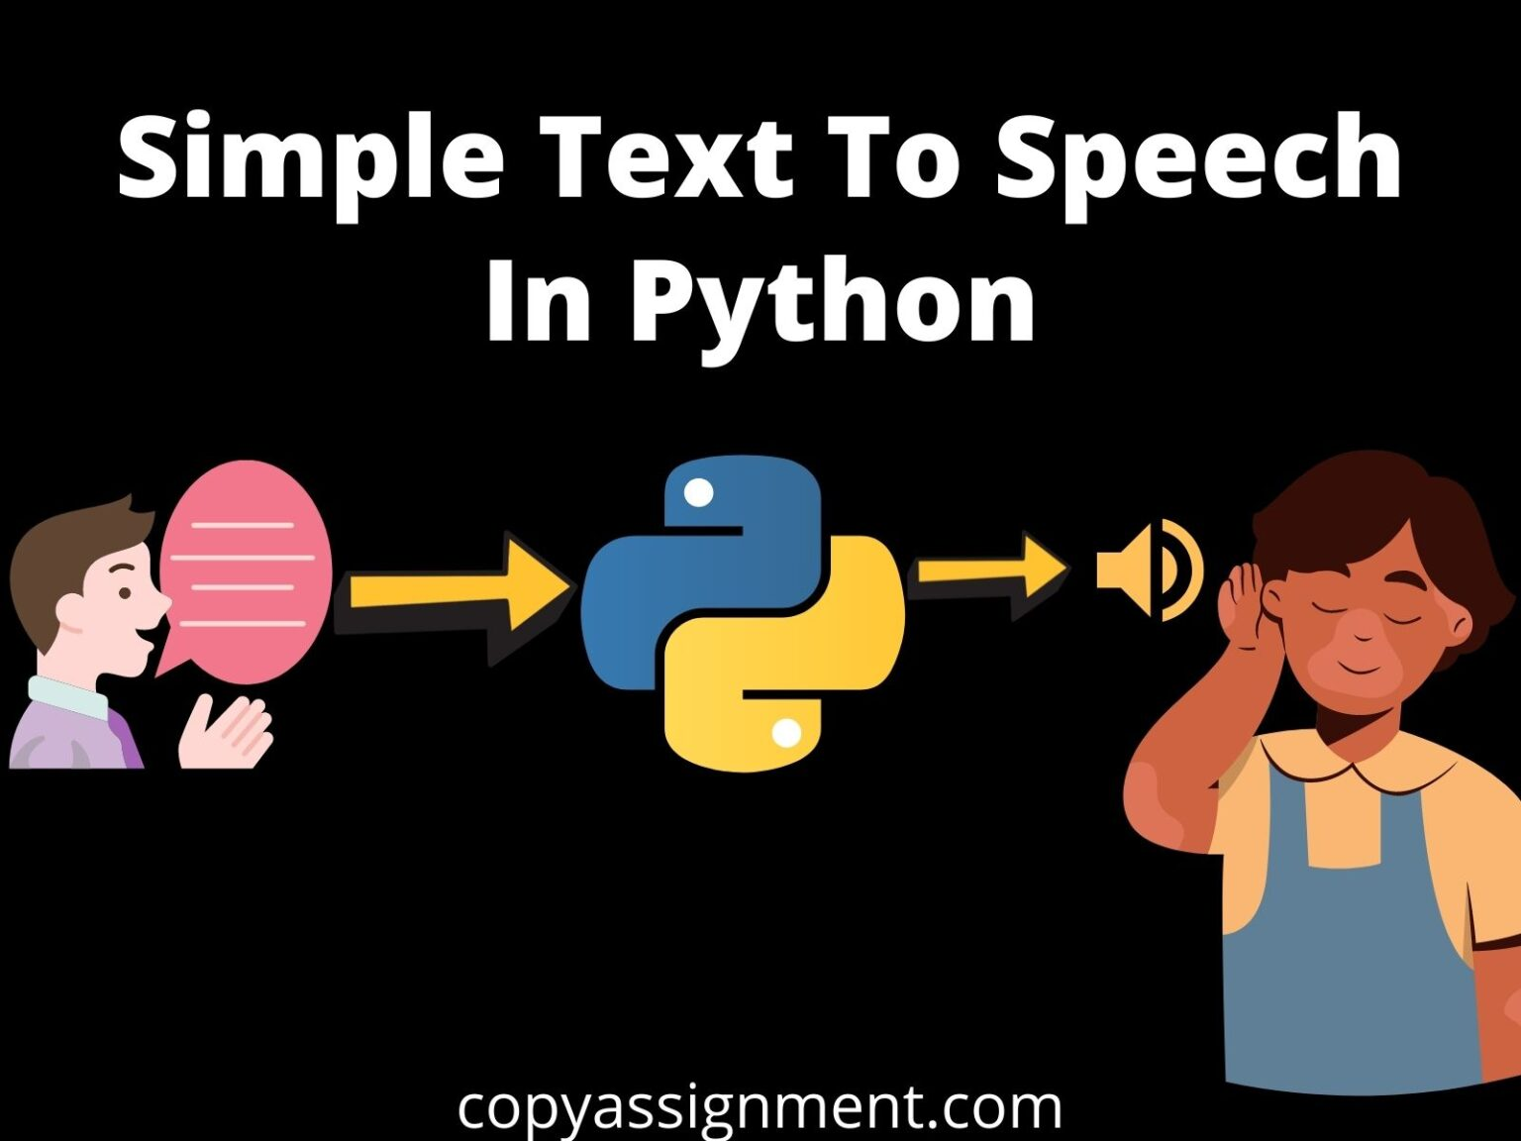
gTTs
The gTTS (Google Text-to-Speech) library in Python allows you to convert text into spoken language using Google's Text-to-Speech API. With gTTS, you can generate speech from text in various languages and save it as an audio file.

Slide 6

Speech_recognition
The speech_recognition library in Python is a versatile library for performing speech recognition tasks. It provides a simple and easy-to-use interface for recognizing speech from various sources such as audio files, microphone input, or online audio streams.

Slide 7

Processor: Any modern processor capable of running Python.
RAM: At least 1 GB of RAM, but more is recommended for better performance.
Storage: A few MBs of storage space for the program files and any temporary audio files.
Microphone: A microphone is required for speech recognition functionality.
Speakers or headphones: Speakers or headphones are required to hear the translated text's audio output.
Hardware Requirements

Slide 8

Software Requirements
Operating System: Windows, macOS, or Linux with Python installed.
Python Version: Python 3.6 or later is recommended.
Third-Party Libraries: The required third-party libraries (googletrans, gtts, speech_recognition) can be installed using the Python package manager pip

Slide 9

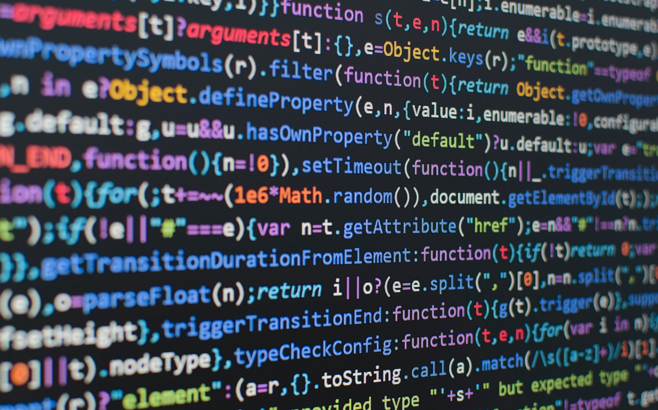
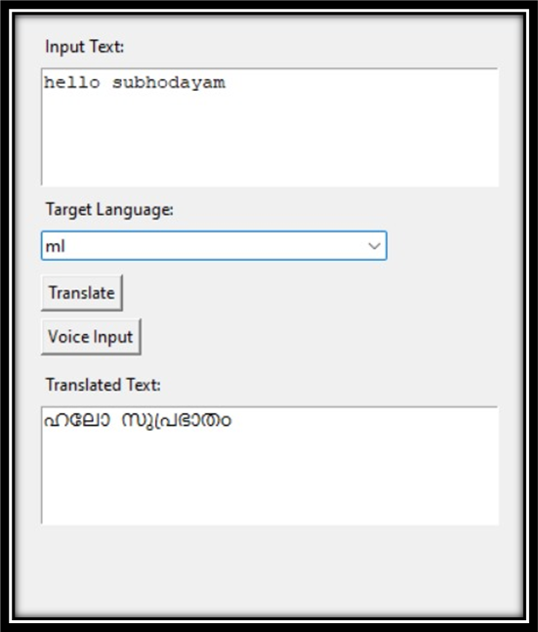
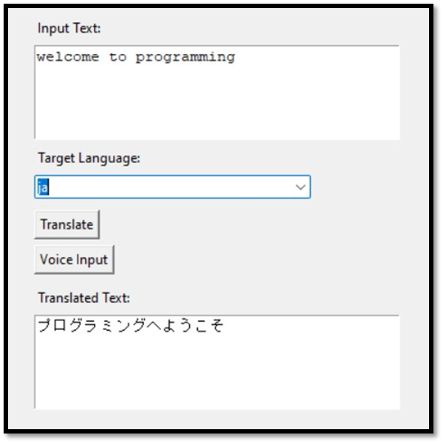
SOURCE CODE
OUTPUT !

Slide 10

Thank You!

